Slide 1


Are you being served: A Framework to manage Cloud outage repair times for Small Medium Enterprises
Jonathan Dunne, David Malone
ISSC2016 – 21st June

Slide 2
Agenda:
1. Introduction
2. Background Research
3. Dataset
4. Analysis
5. Results
6. Conclusion

Slide 3
Introduction
Software as a service (SaaS) is a software licensing and delivery model in which software is licensed on a subscription basis and is centrally hosted.
Small to medium enterprises (SME’s) represent 79% of all employment with the EU. Annual turnover in excess of €440 billion.
Nine out of ten SME’s in Europe have less than ten employees, which makes servicing of cloud outages a non-trivial effort.
SME’s need a framework which can best utilise their limited operations resources to service system outages
The core idea of our framework is to outline which outages types contribute to higher service times.

Slide 4






Background Research
Software as a Service
Key evangelists:
Major Cloud Outage events in 2015
Verizon (40 hours offline)
iCloud (12 & 7 hours)
Windows Azure (2 hours)
Starbucks (2 hours)
Google (Multiple. < 1 hour)
Related Studies
Kleyner & O’Connor : Outage times for repairable systems can be best modeled with a log-normal distribution

Slide 5
Data Set
Our study collected data from:
250 outage reports from a large cloud based system.
Data was collected over a 12-month period (Jan - Dec)
Four main components: Business support System (BSS) Collaboration, Email and Social.
Three data centres deployed globally.
Reviewing the data, the following questions needed answering:
How are the times of cloud outage events distributed ?
Does the distribution vary by component?
Does the distribution differ by failure category?
Does the relationship differ by data centre ?

Slide 6
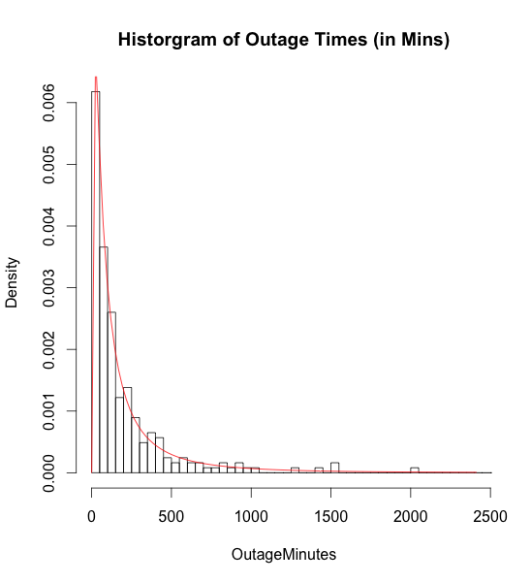
Analysis – Outage Distribution
Fig. I shows the distribution of total outages events
Summary Statistics:
Samples = 246
Mean = 314.14
Std Dev = 1414.43
Median = 105
Skew = 13.80
Distribution = Log Normal
AD Test statistic = 0.29
p-value = 0.95
.

Slide 7
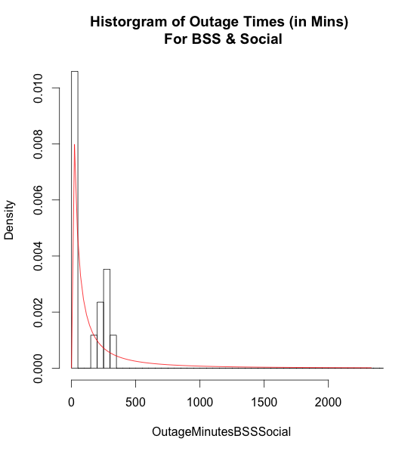
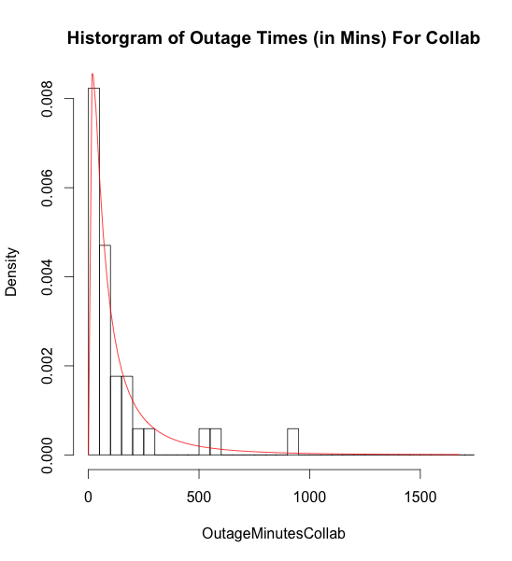
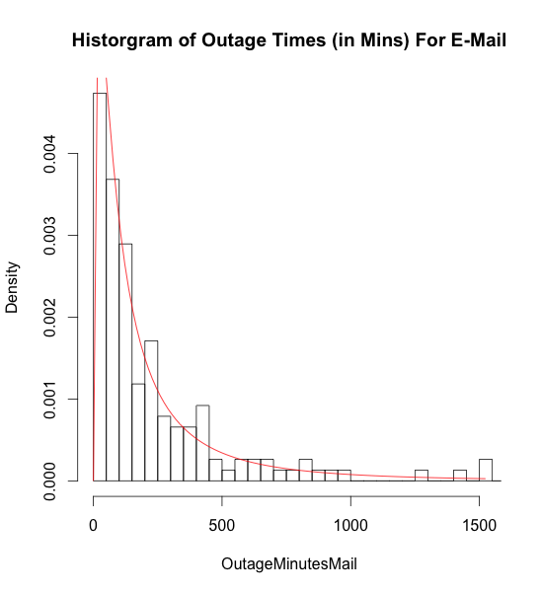
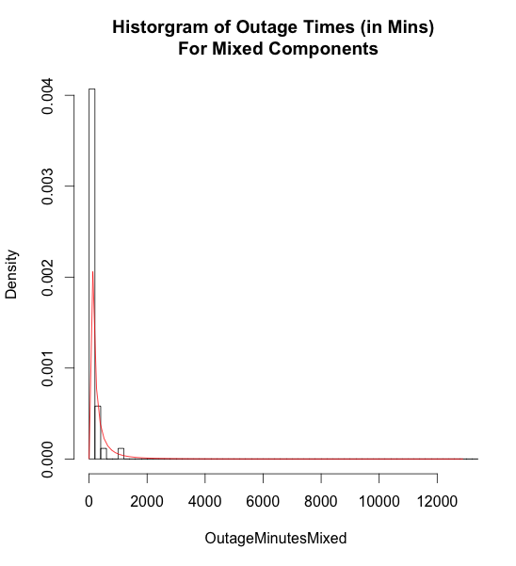
Analysis – Distribution by Component
Fig. 2 shows the distribution of outage events by component: BSS-Social, Collaboration, Mail and Mixed component (More than 2 components).
BSS-Social Statistics:
Samples = 17
Mean = 274.23
Std Dev = 639.44
Median = 45
Skew = 3.56
Distribution = Log Normal
Anderson Darling GOF
AD = 0.555, p-value = 0.690
Collaboration Statistics:
Samples=34
Mean = 189
Std Dev = 379.33
Median = 61.5
Skew = 3.83
Distribution = Log Normal
Anderson Darling GOF
AD = 0.633, p-value = 0.616
Mail Statistics:
Samples= 152
Mean = 258.10
Std Dev = 423.27
Median = 126.5
Skew = 5.45
Distribution = Log Normal
Anderson Darling GOF
AD = 0.180, p-value = 0.995
Mixed Component Statistics:
Samples=43
Mean = 626.95
Std Dev = 3260.78
Median = 85
Skew = 6.30
Distribution = Log Normal
Anderson Darling GOF
AD = 0.608, p-value = 0.639

Slide 8
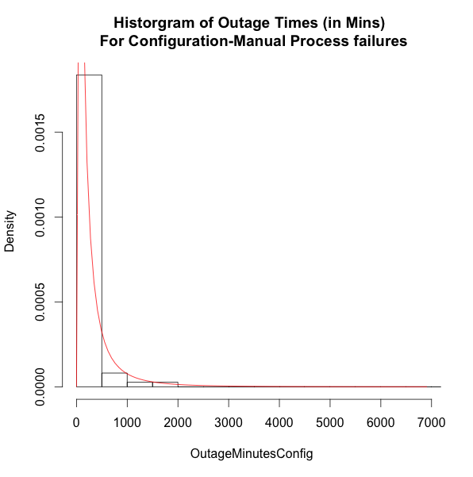
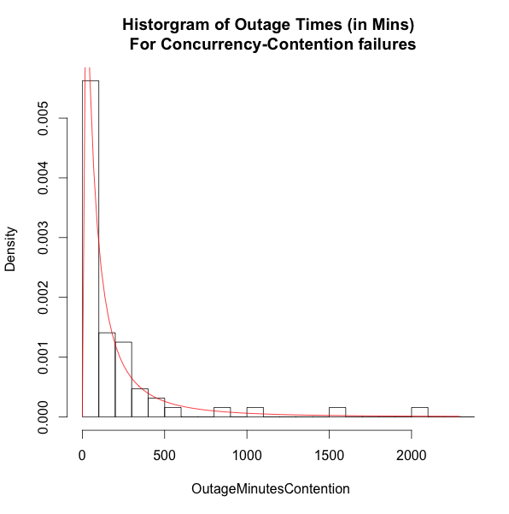
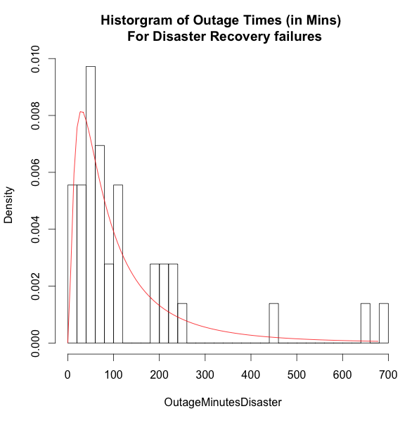
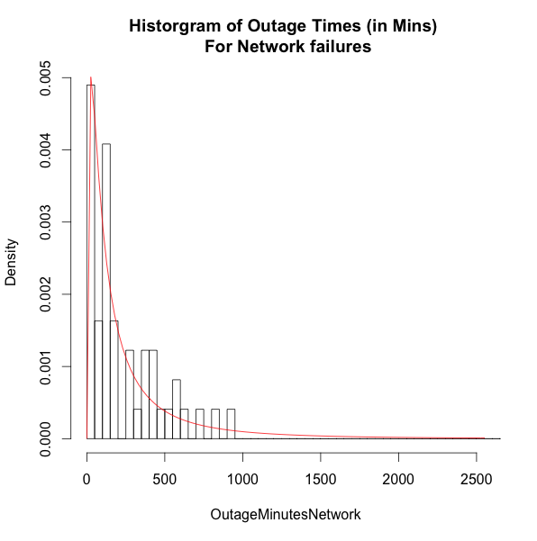
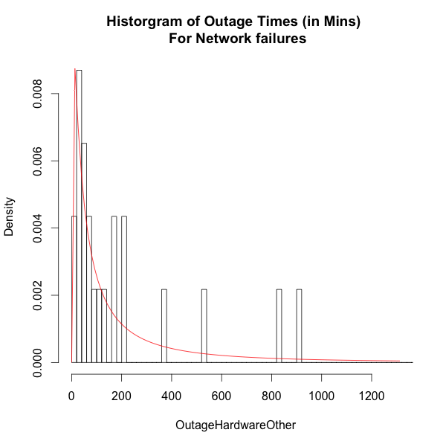
Analysis – Distribution by Failure Type
Fig. 4 shows the distribution of outage events by type: Configuration-Manual Process, Contention-Concurrency, Disaster Recovery, Network and Hardware-Other.
Configuration-Manual Statistics:
Samples = 74
Mean = 488.61
Std Dev = 2488.21
Median = 114.5
Skew = 8.28
Distribution = Log Normal
Anderson Darling GOF
AD = 0.331, p-value = 0.913
Contention-Concurrency Statistics:
Samples = 64
Mean = 238.78
Std Dev = 468.62
Median = 86
Skew = 3.69
Distribution = Log Normal
Anderson Darling GOF
AD = 0.248, p-value = 0.971
Disaster Recovery Statistics:
Samples = 36
Mean = 134.03
Std Dev = 160.72
Median = 72
Skew = 2.33
Distribution = Log Normal
Anderson Darling GOF
AD = 0.293, p-value = 0.943
Network Statistics:
Samples = 49
Mean = 314.59
Std Dev = 590.74
Median = 145
Skew = 5.30
Distribution = Log Normal
Anderson Darling GOF
AD = 0.491, p-value = 0.756
Hardware-Other Statistics:
Samples = 23
Mean = 243.44
Std Dev = 357.54
Median = 91
Skew = 2.11
Distribution = Log Normal
Anderson Darling GOF
AD = 0.275, p-value = 0.956

Slide 9
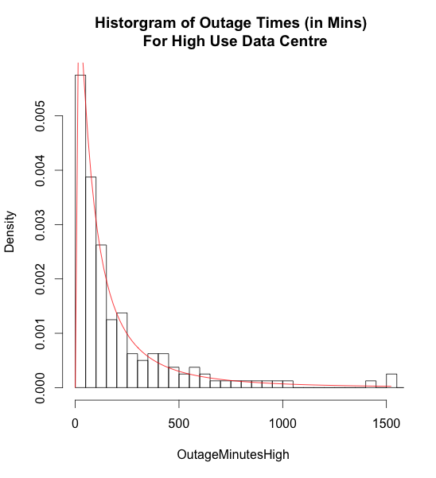
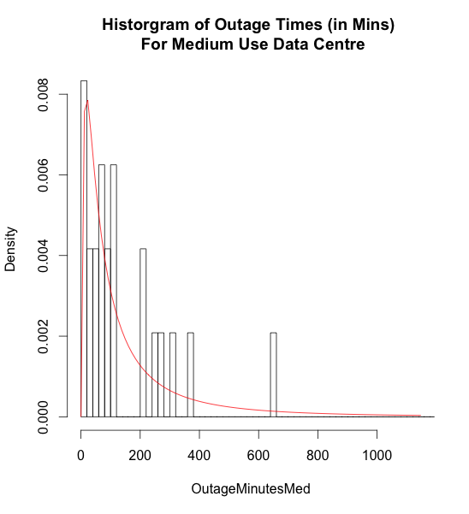
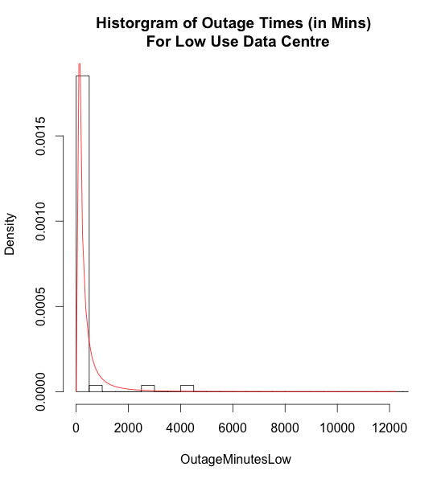
Analysis – Distribution by Data Centre
Fig. 3 shows the distribution of outage events by Data Centre: High, Medium, Low use.
Data Centre (A) High Use Statistics:
Samples = 160
Mean = 224.43
Std Dev = 312.83
Median = 113.5
Skew = 2.93
Distribution = Log Normal
Anderson Darling GOF
AD = 0.177, p-value = 0.995
Data Centre (B) Medium Use Statistics:
Samples = 24
Mean = 187.67
Std Dev = 279.97
Median = 89.5
Skew = 2.89
Distribution = Log Normal
Anderson Darling GOF
AD = 0.215, p-value = 0.986
Data Centre (C) Low Use Statistics:
Samples = 54
Mean = 645.39
Std Dev = 2961.09
Median = 79.5
Skew = 6.67
Distribution = Log Normal
Anderson Darling GOF
AD = 1.085, p-value = 0.316

Slide 10
Analysis – Regression testing for Correlation
The purpose of the Regression analysis is to understand if there is a relationship between outage times and other factors. (e.g. Data centre, component or outage type)
Key findings:
Outage times are strongly correlated with the E-mail component.
Outage times are less strongly correlated to both the BSS components and network outages type outages.
For all other variables there was little evidence of correlation.
Data Centre | Regression effect | p value | Component | Regression effect | p value | Trigger Type | Regression effect | p value
B | Little | 0.651 | BSS | Weak | 0.075 | Config-Manual | Little | 0.473
C | Little | 0.513 | Collaboration | Little | 0.164 | Concurrence-Contention | Little | 0.228
A | Little | 0.72 | Email | Strong | 0.008 | Disaster Recovery | Little | 0.218
Mixed | Little | 0.234 | Mixed Component | Little | 0.172 | Hardware-Other | Little | 0.723
 |  |  | Social | Little | 0.928 | Network | Weak | 0.06
Note: The Lower the P value the higher the level or association / correlation.

Slide 11
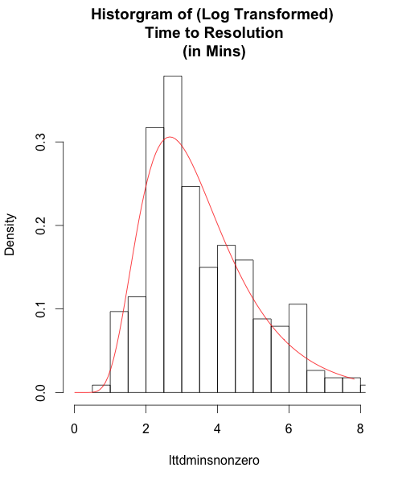
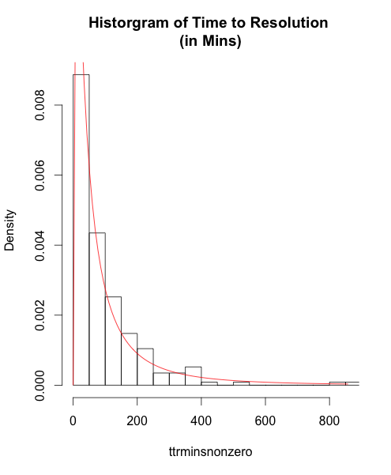
Analysis – TTD Vs TTR
TTD Statistics (Untransformed):
Samples = 229
Mean = 228.81
Std Dev = 1450.44
Median = 24
Skew = 13.57
TTD Statistic (Log Transformed)
Distribution =Log Normal
AD = 0.83, p-value = 0.46
TTR Statistics:
Samples = 230
Mean = 108.25
Std Dev = 162.50
Median = 59
Skew = 4.75
Distribution = Log Normal
Anderson Darling GOF
AD = 0.79, p-value = 0.50

Slide 12
Results
Outage Distribution:
Overall outage times can be successfully modeled by a log normal distribution
The distribution is skewed which suggest great variability in service times.
Component:
Mean outage times vary by component. Collaboration outages recorded the shortest mean outage times, with BSS & Social the longest.
Operations teams can be elastic in size to target specific components on a per outage basis.
Data Centre:
Mean outage times vary by component. Medium use data centres recorded the longest mean outage times, with Low usage the longest.
Operations teams should standardize problem determination techniques to ensure uniform resolution times.
Failure Type:
Mean outage times vary significantly by failure type. Configuration-Human error and Network outages take the longest to resolve.
Investing in best of breed automation assets and state of the art monitoring will significantly reduce configuration issues while providing more awareness of network health.

Slide 13
Conclusion
Our study has shown:
The log normal distribution is an effective method to model cloud outage events repair times.
Outage event data can be used to create outage event resolution frameworks.
Our framework will allow operation teams to focus on specific outage events and rapidly reduce their remediation times.

